Slide 1
Equivalent Annual-worth Comparison
Dr. Bidyadhar Padhi

Slide 2
Equivalent annual worth (EAW) method is another important method for comparing engineering alternatives
With an annual worth method, all the receipts and disbursements occurring over a period are converted to an equivalent uniform yearly payment
Cost accounting procedures, depreciation ,profit and loss are calculated annually .
These yearly cost tabulations generally make the annual worth method easier to apply and comprehend than the other comparison methods
The annual worth calculation is derived from capital recovery factor as it converts a lump sum to an equivalent annuity

Slide 3
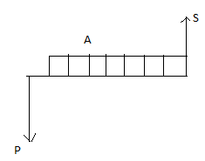
PW= -P +A(P/A,i,N)+ S(P/F,i,N)
FW= -P(F/P,i,N) + A(F/A,i,N)+S
EAW= -P(A/P,I,N)+ A +S(A/F,I,N)

Slide 4
The capital recovery factor (A/P, i, N) accounts for both the repayment of invested capital and the interest earned on the unrecovered portion of the investment. Loan ₹ 40,000 Rate of Interest=10% , N = 4 years
End of Period | Capital not recovered by end of period | Interest due on Unrecovered capital | Amount of capital recovered | Period capital recovery charge
0 | 40,000.00
1 | `
2
3
4

Slide 5
The capital recovery factor (A/P, i, N) accounts for both the repayment of invested capital and the interest earned on the unrecovered portion of the investment
End of Period | Capital not recovered by end of period | Interest due on Unrecovered capital | Amount of capital recovered | Period capital recovery charge
0 | 40,000.00
1 | 31,381.17 | 4000 | 8618.83 | 12,618.83
2 | 21900.45 | 3138.12 | 9480.72 | 12,618.83
3 | 11,471.67 | 2190.05 | 10,428.79 | 12,618.83
4 | 0.00 | 1147.17 | 11471.67 | 12,618.83
 |  | 10,475.33 | 40,000.00 | 50,475.33

Slide 6
Capital Recovery Calculations
When only the amount of unrecovered capital at a certain time is sought, it can be determined directly from the present worth of the remaining payments:
Unrecovered capital (year 3)= A(P/A,10,1)
=12618.83(0.90909)= 11471.65
Unrecovered capital (year 2)= 12618.83(P/A,10,2)
=12618.83(1.73554)= 21,900.48

Slide 7
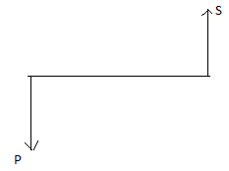
EAW & EAC
EAW = Equivalent Annual worth
Net Annual worth
It has both positive cash and Negative cash flow
EAC= Equivalent Annual worth Comparison
When only the cost of the projects are given and we convert all the cost to equivalent annual amount, it. is called equivalent annual cost.
EAC = P(A/P,i,N)- S(A/F,,i,N)
EAC = (P-S)(A/P,i, N) + S(i)

Slide 8
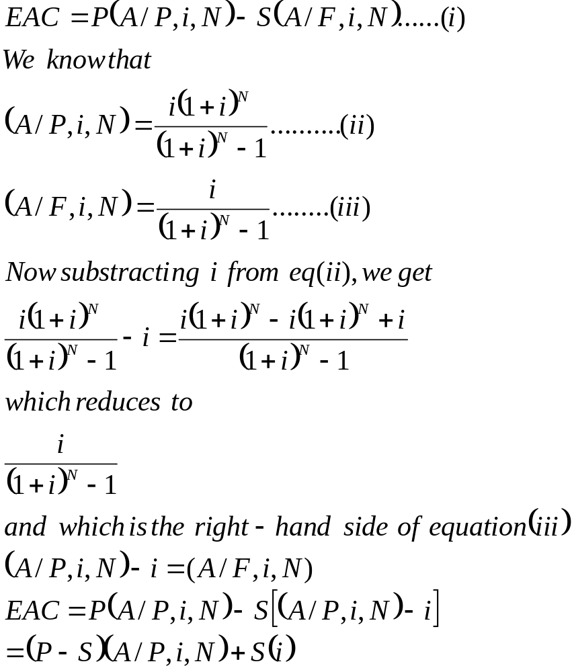

Slide 9
Example:
Initial Cost 1,00,000
Salvage value= 20,000
i=10%
N=4
EAC= 1,00,000(A/P,10,4) -20,000 (A/F,10,4)
= 1,00,000(0.31547) -20,000 (0.21547)
=31547 -4309.4
=27237.6
EAC= (1,00,000-20,000)(A/P,10,4) +20,000(0.10)
EAC= (1,00,000-20,000)(0.31547) +20,000(0.10
EAC= 25237.6+2000
=27237.6

Slide 10
Recovery of Invested Capital
(Will it pay off?)
Initial Cost : Rs. 1,00,000
Annual Revenue : 20,000
Annual Expenses: 5000
Salvage Value: 40,000
i= 8 percent
N= 5
EAW= -1,00,000 (A/P,8,5) + 15,000 + 40,000(A/F,8,5)
EAW = -1,00,000(0.25046) + 15,000 + 40,000(0.17046)
=-25046 + 15,000 + 6818.4
= -3227.6
EAW= - [(1,00,000-20,000)(A/P,8,5) +20,000(0.10)]+15,000

Slide 11
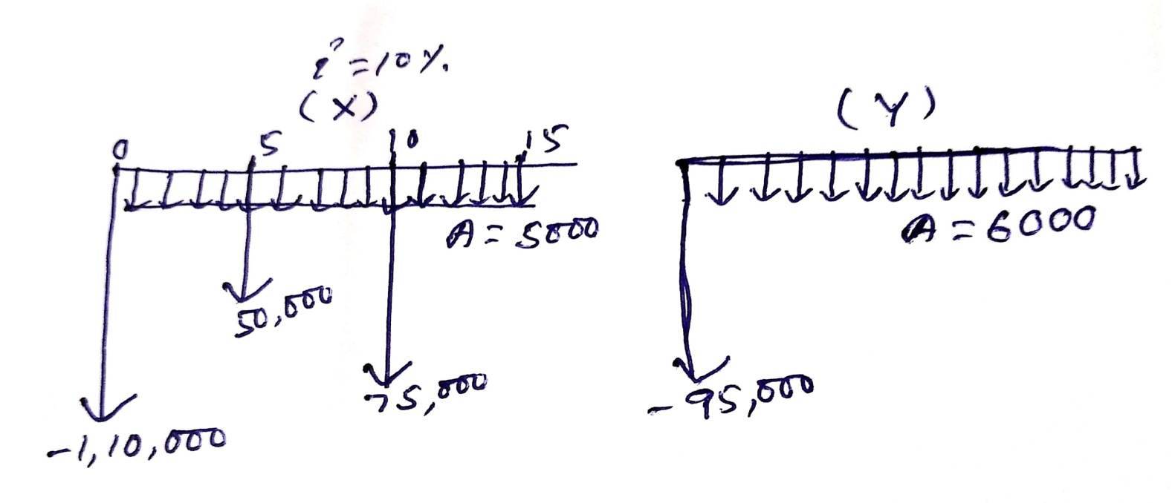
Comparison of Net Annual Costs
 | X | Y
Initial Cost | 1,10,000 | 95,000
Investment in 5th Year | 50,000 | -
Investment in 10th Year | 75,000 | -
Annual Cost | 5000 | 6000
Life | 15 | 15
i | 10 | 10

Slide 12
EAC (X) = 1,10,00 (A/P,10,15) + 50,000(P/F,10,5)(A/P,10,15) + 75,000 (P/F,10,10)(A/P,10,15) + 5000
EAC (X) = 1,10,00 (0.13147) + 50,000(1.61051)(0.13147) + 75,000 (0.38554)(0.13147) + 5000
EAC(X) = 14461.7 + 10586.687 + 3801.520
EAC(X) = 14461.7 + 10586.687 + 3801.520
=28849.907
EAC (Y) = 95,000 (A/P,10,15) + 6000
= 95,000 (0.13147) + 6000
=12489.65 + 6000
=18489.65

Slide 13
Consideration of Asset Life
In time value mechanics N is simply the number of compounding period. N has special meaning when it represents life of the asset. The life of the asset can be defined as follows
Ownership life: Service life (It is the period of time an asset kept in service). It is the period of useful service from the time of purchase until disposal.
Accounting life: This is a life expectancy based primarily on book keeping and tax considerations.
Economic life: It is the time period that minimises the asset's total equivalent annual cost and maximizes its equivalent net annual income.

Slide 14
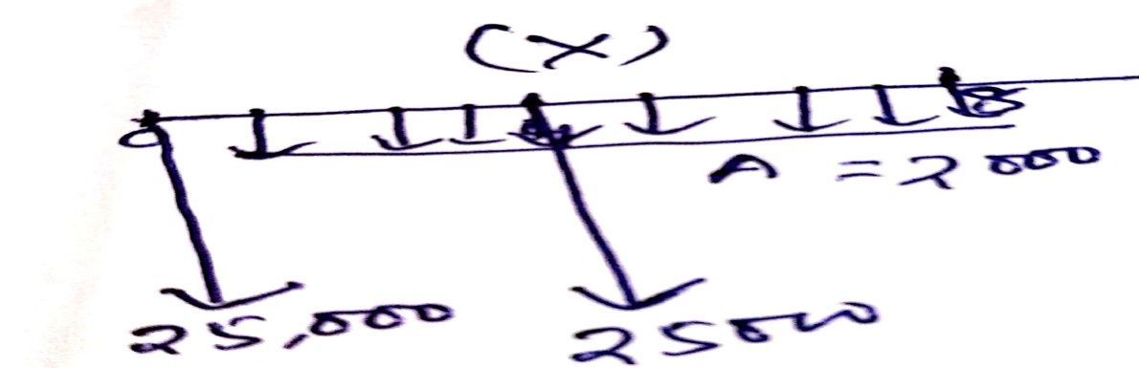
Comparison of Assets having unequal lives
 | X | Y
Initial Cost | 25000 | 30,000
AMC | 2000 | 1000
N | 4 | 8
i | 10 | 10

Slide 15
EAC (X)= 25,000(A/P,10,4) + 2000
EAC (X)= 25,000(0.31547) + 2000
EAC= 7886.75 + 2000
=9886.75
EAC(Y)= 30,000 (A/P,10,8) + 1000
=30,000 (0.18744) +1000
=5623.2+1000
=6623.2
Repeated Life Method
EAC(X) = 25000 (A/P,10,8) + 25000(P/F,10,4)(A/P,10,8)+ 2000
EAC(X) = 25000 (0.18744) + 25000(0.68301)(0.18744)+ 2000
EAC(X) = 4686 + 3200.584+ 2000
=9886.7
EAC(Y)= 30,000 (A/P,10,8)+ 1000
=6623.2

Slide 16
Problems
A company can purchase a piece of equipment for Rs 20,000 and sell it for Rs. 4000 at the end of 6 year service life, or it can lease the unit for the same period by making first-of-the year payments of Rs 3000. Compare the equivalnent annual cost of the alternatives, using an interest rate of 15 percent

Slide 17
EAC (Purchase)= (20,000-4000)(A/P,15,6)+ 4000(0.15)
= (20,000-4000)(0.26424)+ 4000(0.15)
=4227.84+600
=4827.84
EAC (Lease)= [3000 +3000(P/A,15,5)](A/P,15,6)
= [3000 +3000(3.35218)](0.26424)
= [3000 +3000(3.35218)](0.26424)
= [3000 +10056.54](0.26424)
=3450.060

Slide 18
A stand by electric power generator was purchased 6 years ago for Rs 8000. At that time it was expected that the equipment would be used for 15 years and would have a salvage value of 10 percent of the first cost. The generator is no longer needed and is to be sold for Rs. 2500. Using an interest rate of 15 percent determine the difference between the anticipated and actual equivalent annual capital cost.

Slide 19
EAC(Anticipation)=(8000-800)(A/P,15,15)+ 800(0.15)
EAC(Anticipation)=(8000-800)(0.17102)+ 800(0.15)
EAC(Anticipation)= 1231.344+120
=1351.344
EAC(Actual)= (8000-2500)(A/P,15,6) + 2500(0.15)
EAC(Actual)-=(8000-2500)(0.26424) + 2500(0.15)
EAC(Actual)=1453.32+375
=1828.32

Slide 20
Laser beams are to be used on a major construction project to ensure the exact alignment of components. Two types of laser alignment systems, with the cost shown below, are suitable for the projects.
If both system have a life of 4 years and the minimum rate of return is 15 percent, which offers the lower equivalent annual cost.
 | IC System | UC System
First Cost | 5000 | 3200
Salvage Value | 1000 | 0
Annual operating cost | 600 | 950
Annual taxes | 180 | 0

Slide 21
EAC(IC System)= [(5000-1000)(A/P,15,4) +1000(0.15)]+780
EAC(IC System)= [(5000-1000)(0.35017) +1000(0.15)]+780
EAC(IC System)= [(5000-1000)(0.35017) +1000(0.15)]+780
EAC(IC System)=1400.68 + 150+780
=2330.68
EAC(UC System)= 3200(0.35027) + 950
EAC(UC System)= 1120.864+ 950
=2070.864

Slide 22
A company receives two options for purchasing a copier machine for its office.
Option 1: Make a down payment of Rs. 30,000 and take delivery of the copier machine. The remaining money is to be paid in 24 equal monthly installments of Rs. 4500 each.
Option: 2 Make a full payment of Rs. 1,00,000 and take delivery of the copier machine.
Suggest the best option for the company to buy the copier machine based on the equivalent method of comparison by assuming 12% interest rate, compounded annually.

Slide 23
EAC (Option I) =30,000(A/P,1,24) + 4500
=30,000 (0.04707) + 4500
=1412.1+4500
=5912.1
EAC (Option II) = 1,00,000 (A/P,1,24)
1,00,000 (0.04707)
= 4707

